Slide 2
Syllabus
Intro
Get started
Data extraction
Data visualization
What next?

Slide 3
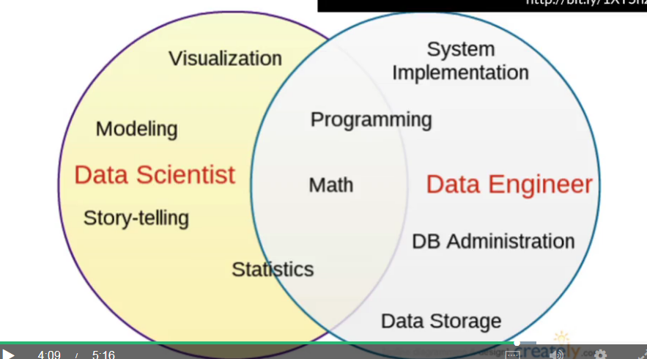
The key world in “Data Science” is not Data, it is Science
Когда кто-то анализирует данные, или пытается использовать данные для развития бизнеса
you're actually using that data to
answer a specific, concrete question that could be useful for your organization.
at the core the question was, how can we identify movies that people will like

Slide 4
Сomponents of Data science
There's the actual data science, the actual learning from data. And doing, discovering what the right prediction model is.
And then there's the implementation component which is often lumped into data engineering which is how you actually implement or scale that technology to be able to apply it to, say, a large customer base or to a large number of people all at once.
And so there are these trade-offs that always come up in data science. The tradeo-ffs between interpretability and accuracy or interpretability and speed, or interpretability and scalability, and so forth.
And so, another component of this is like being able to identify what's hype and what's not.
they care less about the underlying psychology and fundamental truths of why you're doing these things, but more care about, we wanna give the person the most relevant ads, so they click and then they buy things
A/B testing

Slide 5
machine learning as a set of algorithms that take a set of inputs and return a prediction

Slide 6
Давайте скачаем данные с сайта ЦБ и посмотрим, что можно с ними сделать(exploratory data analysis).
Потом необходимо challenge your results

Slide 7
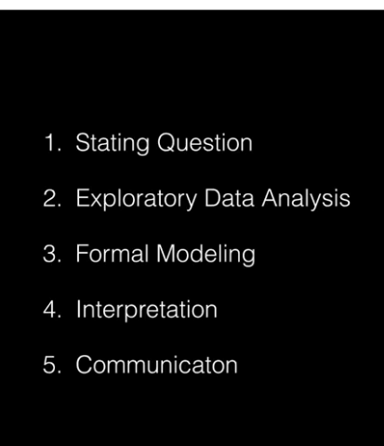
Data science project phases
1. Thinking of the question
2. Getting the data
3. Exploratory data analysis to start to develop a sketch of the solution
4. If you got the right data and it appropriate to move on than formal modeling phase
5. Challenge your result trough the variety of approaches
6. Interpretation phase to get a sense of the totality of evidence with respect to kind of answering the question.
7. Communication phase
Setting Expectations,
Collecting information (data), comparing the data to your expectations, and if the expectations don’t match,
Revising your expectations or fixing the data so your data and your expectations match.
Iterating through this 3-step process is what we call the “epicycle of data analysis.” As you go through every stage of an analysis, you will need to go through the epicycle to continuously refine your question, your exploratory data analysis, your formal models, your interpretation, and your communication.

Slide 8
Type of questions you can ask with data analysis
Descriptive
Exploratory - trends and relationships between variables in your data set
Infernatial
Predictive – you can take a set of features and use them to predict another feature
Causal
Mechanistic
For example, we often think we're asking a causal question, but the way that we've done the analysis or collected the data is really results in us asking an inferential question, and that is the classic correlation does not imply causation type of problem. Another good example is when we think we're doing inferential, we're asking an inferential type of question. But in reality we're doing something more exploratory and so that's sometimes called data dredging. Another mistake that's commonly ma...

Slide 9
pip — это система управления пакетами, которая используется для установки и управления программными пакетами, написанными на Python. С её помощью устанавливаем библиотеки, которые будем использовать:
sklearn — библиотека, алгоритмов машинного обучения, она понадобится нам в дальнейшем для классификации исследуемых данных,
matplotlib — библиотека для построения графиков,
pandas — библиотека для обработки и анализа данных. Будем использовать для первичной обработки данных,
numpy — математическая библиотека с поддержкой многомерных массивов

Slide 10
Get started
import pandas as pd
import numpy as np
import pycountry
import matplotlib.pyplot as plt from matplotlib
import warnings warnings.filterwarnings('ignore')
import cm from mpl_toolkits.mplot3d import Axes3D

Slide 11
n an Unsupervised case you're trying to build a prediction where you don't actually have the outcome to train the algorithm. So I would define unsupervised learning as trying to uncover unobserved factors. And some examples of this would be clustering, mixture models and principal components. To give you an example I will go back to one of the first examples of clustering. And that is, for the famous g factor is psychometrics. So people like Spearmen, a famous psychometrician and statistician, used factor analysis to combine collection of questionnaire data to find that people who took these tests, these psychometric tests, tended to cluster. They hypothesized that these clusters represented some outcome, some unmeasured outcome that represents some kind of intrinsic intellectual ability. So this was one of the first examples of unsupervised clustering done well before the advent of computers I might add.
supervised learning is using a collection of predictors and some observed outcomes to build an algorithm to predict this outcome when it's not observed. So some examples of supervised learning algorithms include random forests, boosting, support vector machines. supervised learning is using a collection of predictors and some observed outcomes to build an algorithm to predict this outcome when it's not observed. So some examples of supervised learning algorithms include random forests, boosting, support vector machines.

Slide 12
Movie recommendation for Netflix– как похожий эксперимент провести используя данные о платежах клиентов?

Slide 13
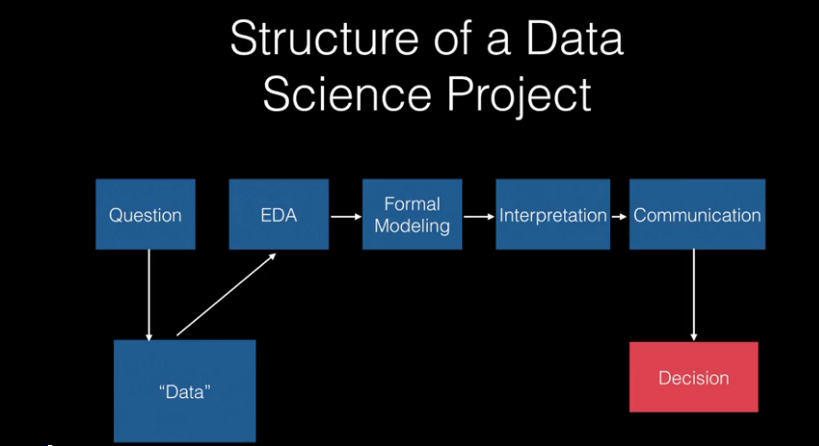

Slide 14
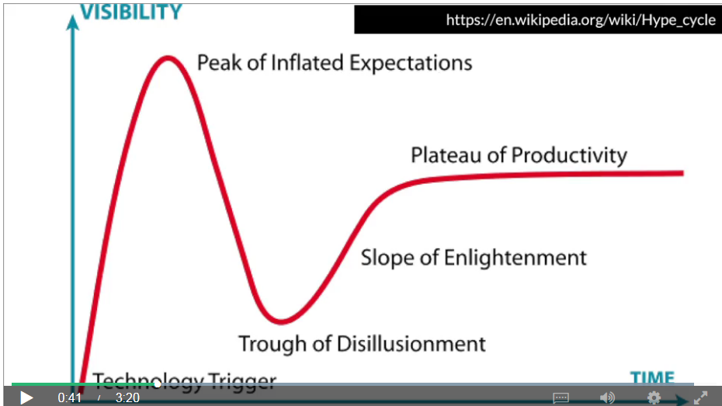
Data science toolbox
Usually, most of the analysis that takes place and most of the production doesn't actually happen in the database, it happens elsewhere. So, you usually have to pull it out with another programming language to pull the data out of that database and analyze it. So, the two most common languages for doing that.
the next tool that is in the data scientist toolbox is actually communication. A data scientist or a data engineer has a job that's typically changing quite rapidly as new packages and new sort of tools become available, and so the quickest way to keep them up to speed is to have quick communication and to have an open channel of communication.
The first order of business is just making sure your sort of data house is in order. And the way to do that is to make sure you focus on infrastructure. So the first thing that you need to do is build out the infrastructure for storing the data, the databases and so forth. The software that's gonna be run to pull those data, the servers that are gonna serve the data to other people, and the servers that you'll interact with yourself in order to get the data out. So all that sort of requires infrastructure building up at first

Slide 15
Data engineer vs Data scientist
There are a few sort of key things that they need to know, they might need to know how to build and manage some databases, things like SQL, things like MongoDB. They might also need to know how to do things like implement or run, things like Hadoop, which is a parallel processing infrastructure. So what does a data engineer do? They might do things like build infrastructure. So they would build out what are your databases, the hardware for that. Whether it's purchasing that, and organizing it, and ordering it. Or they might build out your system for actually computing on that, whether it's what servers they're gonna buy and how they're gonna organize that. And what software they're gonna run on top of the database, what software they're gonna run on top of the server. And then, they manage the data storage and use. So they might monitor how those work.
So what does a data scientist do? As it's typically defined, a data scientist runs experiments, pulls and cleans data, analyzes it and then communicates the results to people. So they need to be able to do statistics. So, often they'll have learned that either in classes, so that they will have a qualification in statistics, whether it's a degree or they've taken a large number of classes, or they've taken some online classes. They probably need to know something about prediction and machine learning.So they need to be able to do statistics. So, often they'll have learned that either in classes, so that they will have a qualification in statistics, whether it's a degree or they've taken a large number of classes, or hey've taken some online classes. They probably need to know something about prediction and machine learning.

Slide 16
What a success is?
And you can identify these organizational problems as a way, as a target to try to hit. Now, sometimes data is useful for those and sometimes it isn't. So setting specific targets like that, like a percent growth increase, can be very hard to hit all the time.
Solving an internal problem might be cleaning up the code, cleaning up the documentations, and getting it ready for other people to use.
The data don't necessarily always do exactly what you want them to do.
So, the first thing that a data scientist needs to do to be really effective is to be working on a concrete problem. And those concrete problems often don't come out of the data science team, they often come out of another team.

